Slide 1
Google Earth Web
GskyGE_DEA
A web app to use Google Earth Web with DEA
Creates KMLs for Google Earth Web (GEWeb) to simulate GSKY Web Map Service.
This app is by far the only way to display GSKY Web Map Service in both spatial and temporal dimensions outside of TerriaMap.
Copyright © 2019 by National Computational Infrastructure, Canberra, ACT, Australia.
Author: Dr. Arapaut V. Sivaprasad.
02 April, 2019

Slide 2
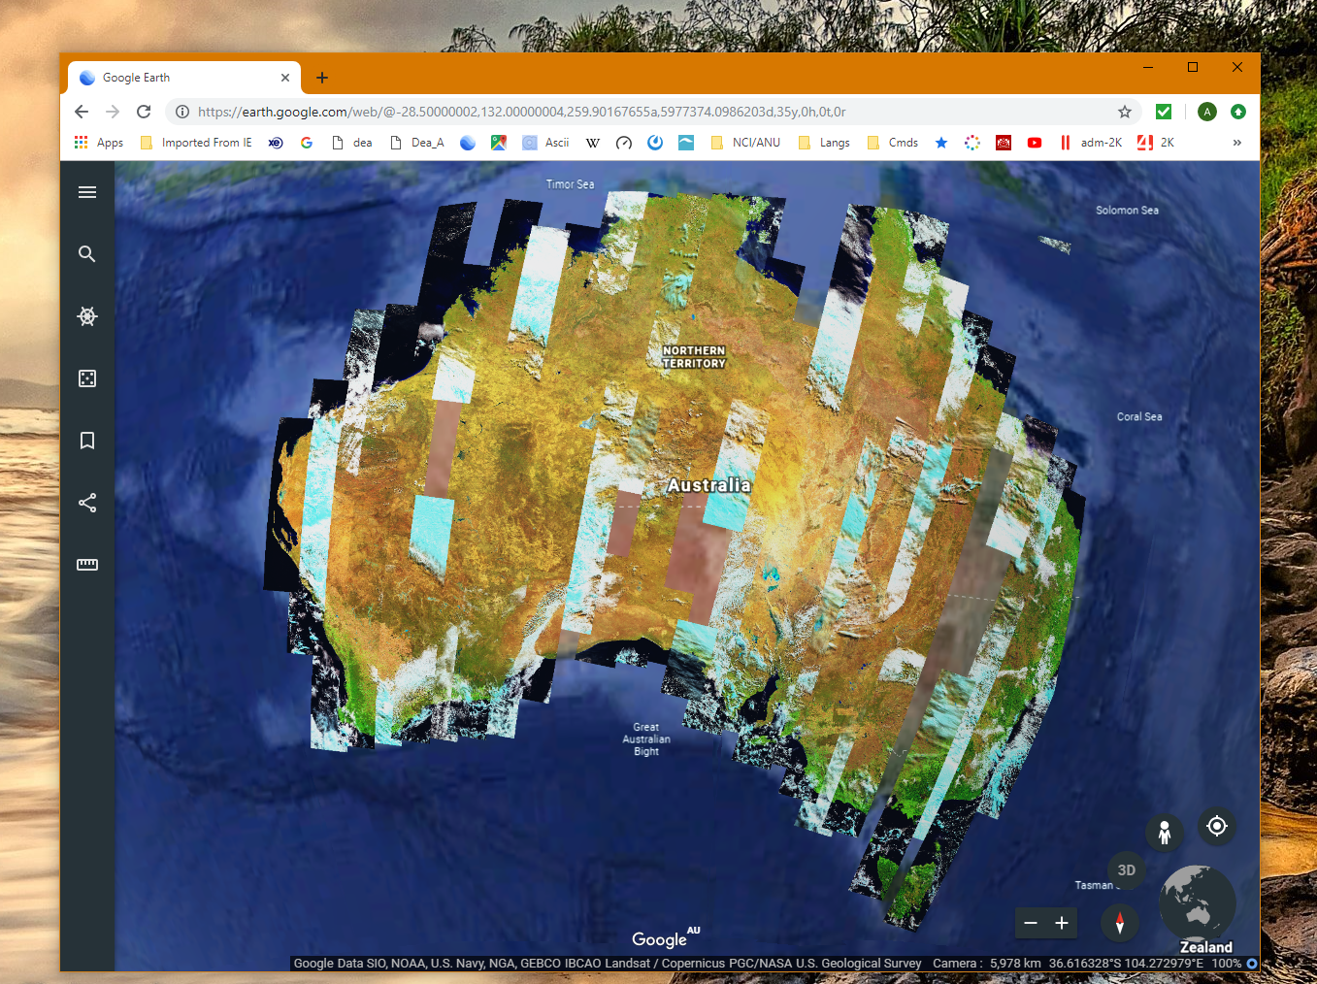
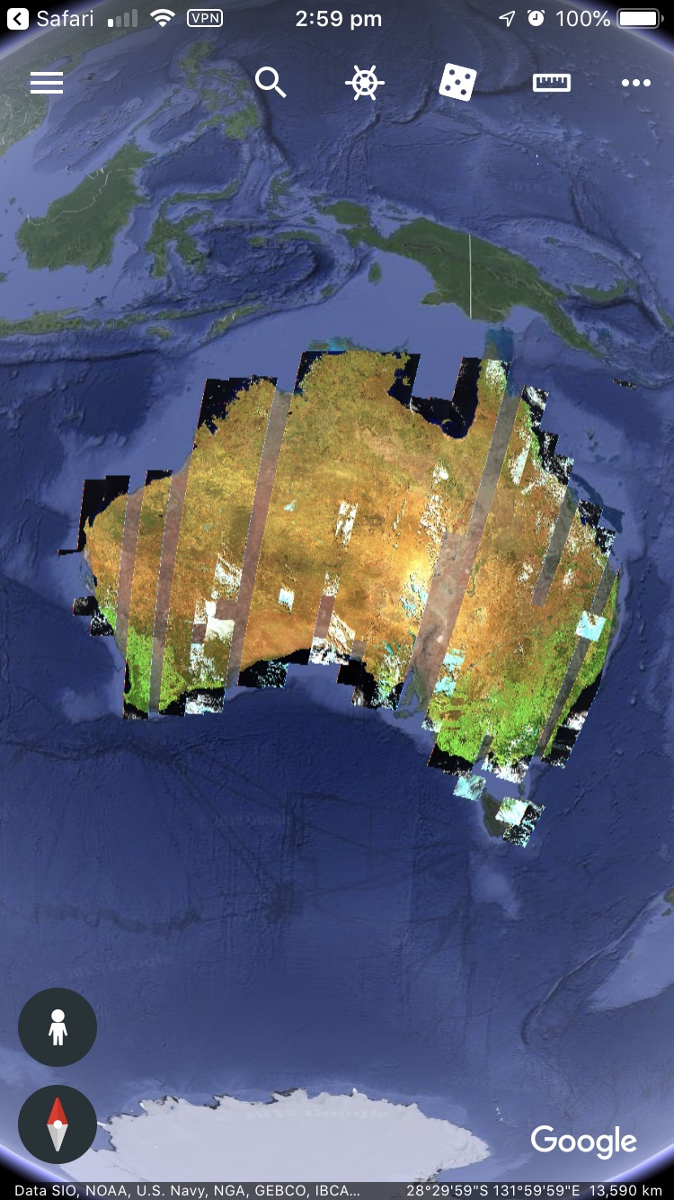
INTRODUCTION
Slides 2-10 are for developers. Slides 11-19 form the user guide.
Google Earth Web (“GEWeb”) is a web-based version of the Google Earth Pro desktop (“GE”). While there are many new features, it lacks some that are in GE. Of these, the main missing item is a WMS facility. Unlike GE which can take a WMS server URL (e.g. GSKY server) and display the layers, GEWeb lacks this feature. It uses a KML (Keyhole Markup Language) to display static images.
The primary advantage of using GEWeb over GE is that it is platform independent. But it is browser-dependent and currently works only in Google Chrome. There is a mobile app as well.
Google Earth Mobile
Google Earth Web
To GSKY it offers another advantage as well. While WMS is possible in GE, there is no way to display time-based layers. The “GetMap” request sent by GE does not carry the “TIME=“ parameter. There is no way, as yet, to add this by us. Hence, only the latest time slice can be shown.
To speedup the display, the layers are pre-fetched as PNG images and saved on disk. These images are sent as “tiles” to GEWeb to construct the layers. The low resolution tiles, as 3x3 degrees, are generated for the entire continent for all layers and dates. It is a one-off process that took around 60 hours and used up 14GB of disk space.
For high resolution images the calls are made on request, but the tiles are still saved as PNG and sent as static images.
This tutorial is about GEWeb for DEA and describes its use on Chrome and mobiles.
NOTE: Unlike in a WMS service as in TerriaMap, ArcGIS or even GE, zooming in/out or panning the map will not change the image to cover more regions. It will continue to show the same image resized to suit.
Next: Technical Details

Slide 3
Technical Details
KML Syntax:
A minimal KML file to show a layer will have the following:
Headers:
<?xml version="1.0" encoding="UTF-8"?>
<kml xmlns="http://www.opengis.net/kml/2.2" xmlns:gx="http://www.google.com/kml/ext/2.2"
xmlns:kml="http://www.opengis.net/kml/2.2" xmlns:atom="http://www.w3.org/2005/Atom">
Body:
<Document>…</Document>
Item container:
<GroundOverlay>…</GroundOverlay>
Title:
<name>sentinel2_nbart_daily</name>
Visibility setting:
<visibility>1</visibility>
Image Spec:
<Icon>… </Icon>
GetMAP request
<href>…</href>
Coordinates:
<LatLonBox>…<LatLonBox>
End:
</kml>
Example KML:
<?xml version="1.0" encoding="UTF-8"?>
<kml xmlns="http://www.opengis.net/kml/2.2" xmlns:gx="http://www.google.com/kml/ext/2.2" xmlns:kml="http://www.opengis.net/kml/2.2" xmlns:atom="http://www.w3.org/2005/Atom">
<Document>
<GroundOverlay>
<name>sentinel2_nbart_daily</name>
<visibility>1</visibility>
<Icon>
<href>
http://130.56.242.19/GEWeb/DEA_Layers/sentinel2_nbart_daily/2015-07-12/0.1/128.8_-25.8_128.9_-25.7_2015-07-12_0.1.png
</href>
</Icon>
<LatLonBox>
<north>-10.919618</north>
<south>-44.087585</south>
<east>153.984375</east>
<west>112.324219</west>
</LatLonBox>
</GroundOverlay>
</Document>
</kml>
Next: Steps to Build the Web App

Slide 4

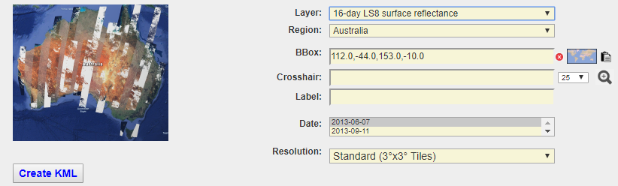
Steps to Build the Web App
http://130.56.242.19/geoglam.html
STEPS
Customise a front page.
Insert a web form using Ajax/CGI.
Generate the KML based on user input.
Download and save the KML file.
Open the KML in Google Earth Web or Mobile.
Generating the KML:
Javascript and Ajax based form.
Selecting a GSKY layer gets its available dates of acquisition.
These are hard coded in a JS file.
Selecting a geographical region gets its Lat/Lon coordinates.
These are hard coded in a JS file.
Can select only one date per KML.
Can change the Lat/Lon coordinates of a bounding box.
Use the inbuilt “BBox Finder” to find the values for any area.
Or, use the crosshair to zoom around it.
The form input values are sent to a CGI on a webserver.
The CGI generates a KML file and store it as *.kml on the server.
A clickable link is sent back to the page to be displayed.
User clicks this link to download the KML file.
This KML is opened in GE Web and GE Mobile.
Code:
HTML and JavaScript.
See the GitHub repo.
ajax.js
AJAX functions to send and receive from CGI.
Data acquisition times for the GSKY layers.
CGI: google_earth.cgi
See the GitHub repo.
NOTES
A few geographical regions are hard coded in the page. This includes Australia as a whole and each state separately. The user can specify any other region by finding its bounding box values.
Choosing the entire continent at high resolution will time out. Even at state levels it will require too many calls to the GSKY server.
Displaying on Google Earth Web:
My Places | Import KML File
Displaying on Google Earth Mobile:
Click “Open in Google Earth”
Next: Publish the Web App

Slide 5
Publish the Web App
If there is a webserver listening on port 80 or 443 it is a simple matter of cloning the following GitHub repo into a suitable directory under your HTML root. You must also create or copy the tiles to the same web server. See slide 9 for creation of tiles in: /local/GEWeb/DEA_Layers
Github Repo:
https://github.com/asivapra/gsky/tree/master/GSKY_Clients/GoogleEarth/WebGoogleEarth
The Web App can be tested at: http://130.56.242.19/dea.html
If there is no publicly facing webserver on the Linux machine, you can start a minimal webserver using Python as below.
For Python 2.x:
python -m SimpleHTTPServer&
For Python 3.x:
python -m http.server
In both cases the webserver will listen on port 8000. Unless this port is open to the world you will have to create an SSH tunnel to access the page. See slide 9 in GSKY-Thredds_Integration.pptx to learn about SSH tunneling.
While the http server is running and the SSH tunnel is open, you can view the web app by the URL: http://localhost:8000/WebGoogleEarth/geoglam.html
Next: Hints and Tips

Slide 6
Hints and Tips
NOTES
The GSKY version that is compatible with GE and GEWeb resides on a VM behind the NCI firewall. It will work only if you have a VPN connection to the NCI network.
GEWeb is NOT a WMS-enabled client like TerriaMap, ArcGIs, Google Earth Desktop, WorldWind, etc. In this document we explain its KML-based display of images to show GSKY layers.
There is no difference in the data being fetched, except that it is static. You cannot pan or zoom to see more data. Instead, GEWeb will use the same data.
While the above limitation makes it slightly more cumbersome to use, zooming and panning can be done indirectly by supplying the Lat/Lon coordinates.
The picture quality of the globe and the GSKY layers are better than on all other clients. Google’s gimmicks in rotation of the globe, display of clouds, etc. are aesthetically pleasing too.
Google Earth Mobile is by far the only mobile app that can display GSKY layers, if you have a VPN connection on the mobile.
TIPS
Always save the layer after you add a KML file. It will stay across browser sessions, but only on the device where it was saved.
Select multiple time slices if you wish to explore. Each time slice will become a separate layer.
Too many layers open at the same time may result in a crash of the app. This is due to the high RAM usage by Chrome.
Next: Program Logic

Slide 7
Program Logic
BACKGROUND
Google Earth Web (“GEWeb “) does not have a WMS facility and hence it cannot behave like TerriaMap or any other client, including Google Earth Desktop, to send multiple calls to the GSKY server as “Service=WMS&Request=GetMap”. The clients that have WMS facility will construct these requests by using the BBox values corresponding to the visible part of the map (the “canvas”) and send them as web requests. The GSKY server, which listens on port 80 or 8080, fulfills these requests and sends back an image of a small area (“tile”) corresponding to the BBox. The client receives these images and displays them over the map area represented by the Bbox.
GEWeb cannot do the above, as there is no WMS facility.
But, GEWeb has the ability to read and execute a KML file. In it one can define a Bbox and the URL of an image to be displayed over that area. This facility is meant to be used for overlaying landmarks over a map, such as buildings, farms, forests, etc.
In GskyGE we are using this feature to overlay the satellite images returned by GSKY. If we can define the Bboxes for a given area (say, Australia) it can be sent as one GetMap request or split into several requests.
With the DEA satellite images we cannot send it as one GetMap request, since GSKY cannot handle the load created by the large image. Hence, we must split it up into small chunks and send all requests to GSKY. This is done by selecting a small area or using pre-built “tiles” to cover the entire continent.
KML
See slide 3 for a minimal KML file specification.
TILES
Tiles are the base units for displaying the images. These tiles correspond to a small area represented by a Bbox. The KML file includes these tiles as separate “GroundOverlays” and will have the Bbox specified as “LatLonBox” and the image as either a static PNG image on our webserver or a GSKY call for “Service=WMS&Request=GetMap”
GroundOverlay
As the name suggests, this is an item container for the images to be shown above the ground on the map. These images will move/resize if the map is moved, panned or zoomed, but will remain in place over the specified Bbox.
RESOLUTION
Unlike in WMS, where zooming in/out sends a new GetMap request with different BBox values, in the case of GEWeb the new request sends the same values that are hard coded in the KML. To see fine granularity of the terrain, we must use small tile dimenions. Similarly, to cover the entire continent we must use large tile dimensions.
We are using 2 levels of resolutions, viz. Low and High. The High resolution is to be overlaid on a small area. Trying to display them over the entire continent will either take an enormous amount of time to display or crash the GEWeb due to RAM fill-up.
Next: Program Logic (Contd.)

Slide 8
Program Logic
CONSTRUCTION STEPS
Each layer in the DEA datasets must be separately prepared. To create the tiles we use a CGI to call the GSKY server internally and save the images as *.png files. This allows the CGI to call either the development or production GSKY server.
curl 'http://130.56.242.19/cgi-bin/google_earth.cgi?WMS+landsat8_nbart_daily+114.0,-21.0,117.0,-18.0+2013-03-19+3+create_tiles&BBOX=0,0,0,0'
It will create a PNG file in /local/GEWeb/DEA_Layers/Layer/Date/Resolution on the VM where the CGI runs.
The directory structure:
/local/GEWeb/DEA_Layers/Layer/Date/Resolution
Tiles in /local/GEWeb/DEA_Layers/Layer/Date/3 must be retained permanently.
Tiles in /local/GEWeb/DEA_Layers/Layer/Date/0.1 are created on request. They can be purged to save space.
The HTTPD Rootdir must be specified in httpd.conf as /local/GEWeb or a soft link from the normal HTTPD Root dir must be created.
e.g. ln -s /local/GEWeb /var/www/html/GEWeb
lrwxrwxrwx. 1 root root 13 Apr 22 15:47 GEWeb -> /local/GEWeb/
Next: Creation of the tiles

Slide 9
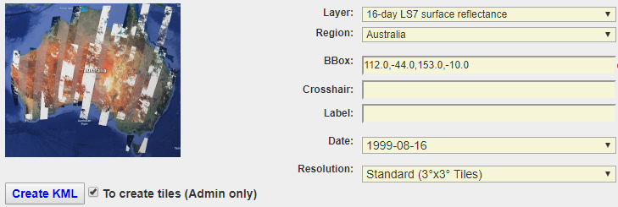
Creation of Tiles
The quality of display depends on the granularity of the tiles. The whole continent of Australia has been divided into tiles of two sizes, squares of 3x3 degrees and 0.1x0.1, respectively. The limit of GSKY to create a tile is around 5x5 degrees.
The larger the tiles, the fewer numbers of them and hence less storage space requirement. However, details will become fuzzier when zooming in. The 3x3 degree and 0.1x0.1 tiles are the optimum largest and smallest. At the continent level zoom there is no recognizable difference between these, whereas zooming in quickly loses clarity with the 3x3 tiles.
Creation of tiles
Currently, the tiles are created semi-automatically, and takes several minutes to hours per layer.
STEPS
SSH to the VM
Shut down the GSKY server and start Apache
pid=`ps -ef | grep gsky | grep -v grep | awk '{split($0,a," "); print a[2]}'`
kill $pid
service httpd start
Open the page: http://130.56.242.15/dea_admin.html
Choose ‘Australia’ as the region and the ‘Standard’ resolution.
Choose the layer.
Check ‘To create tiles’
Click ‘Create KML’
Shut down the Apache and restart GSKY server
service httpd stop
cd /home/900/avs900; ./short_build.sh
Run the tile creation
cd /local/GEWeb; source create_tiles.sh
Tiles wil be created in /local/GEWeb/DEA_Layers
Takes several hours to complete.
STEPS (contd.)
Restart Apache
service httpd start
The system is now ready for use. Test as below.
Open http://130.56.242.15/dea.html
Create a KML for a chosen region and resolution.
Save the KML and open in GEWeb
Next: Stats and Usage

Slide 10
Stats and Usage
Tiles are static images (*.png) created by GSKY. They are fast to display on GEWeb but will take up considerable amount of space on the hard disk. Given below are some indicative sizes.
/local/GEWeb/DEA_Layers
# du -sh *
1.2G landsat5_geomedian
2.8G landsat5_nbar_16day
38M landsat5_nbar_daily
334M landsat5_nbart_16day
48M landsat5_nbart_daily
994M landsat7_geomedian
1.6G landsat7_nbar_16day
103M landsat7_nbar_daily
733M landsat7_nbart_16day
104M landsat7_nbart_daily
283M landsat8_geomedian
1.5G landsat8_nbar_16day
98M landsat8_nbar_daily
1.9G landsat8_nbart_16day
122M landsat8_nbart_daily
190M sentinel2_nbart_daily
13M wofs
USAGE
There is no visible difference between any resolution at continent level.
The 3x3 and 0.1x0.1 tiles looks almost the same at this zoom level.
The recommened way of operation is…
Choose ‘Australia’ and the ‘Low (3x3)’ resolution.
Create the KML and open it in GEWeb.
It will show all swaths across the continent.
Depending on your Internet speed it takes as low as 3 seconds.
Locate a small area of interest and find its BBox.
Use the built-in Bbox finder or its crosshair.
Choose the ‘High (0.1x0.1)’ level of resolution.
Create the KML and open it.
These tiles will zoom in to the maximum without losing clarity.
Browser Caching
When using the GSKY server directly, as in WMS service, the browsers do not cache the data. This results in multiple calls to the server to get the same data over and over again, when the map is panned or zoomed even slightest. It can potentially cause too much server load in addition to slow display on the map. It was observed during the creation of tiles (3x3 degrees) that the server load went to over 16 even though a single GSKY call was sent at a time, but several hundreds continuously.
In a regular GSKY call to the WMS service the requests are for small tiles, but there will be several dozen calls sent simultaneously. The effect of this on server load is not yet determined but is expected to be high. If so, more than 2 or 3 concurrent users may overload the server.
To solve the above problem, the tiles are saved as PNG files and called as images in a HTTP call. The server load is reduced to almost nil.
Next: User Guide

Slide 11
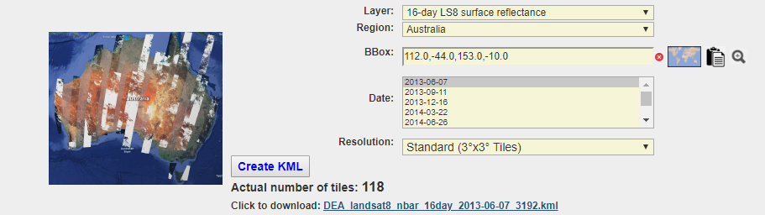
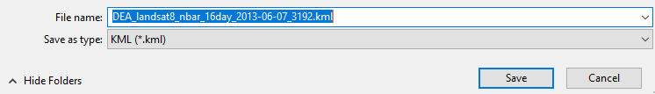
User Guide
The slides from here on must be viewed as a slide show to see all elements.
Create the KML
http://130.56.242.19/dea.html
Next: Display in Google Earth Web
Notes:
Basic operation:
http://130.56.242.19/dea.html
Select the required layer.
Select Australia or one of the states.
Choose a date.
Click ‘Create KML’
Click the download link that appears and save it as *.kml.
NOTES:
1. Unlike in the case of GEOGLAM, it is not possible to display more than one layer in the same KML file. Hence, the date dropdown will allow only one date selection.
2. The standard resolution will display for the whole continent, but high resolution should only be used with a very small bounding box or crosshair zooming.
3. With standard resolution, the process will finish with a second. The High resolution may run for a while.
4. A process that has been running for excessive time can be cancelled by clicking the ‘Cancel’ button.

Slide 12
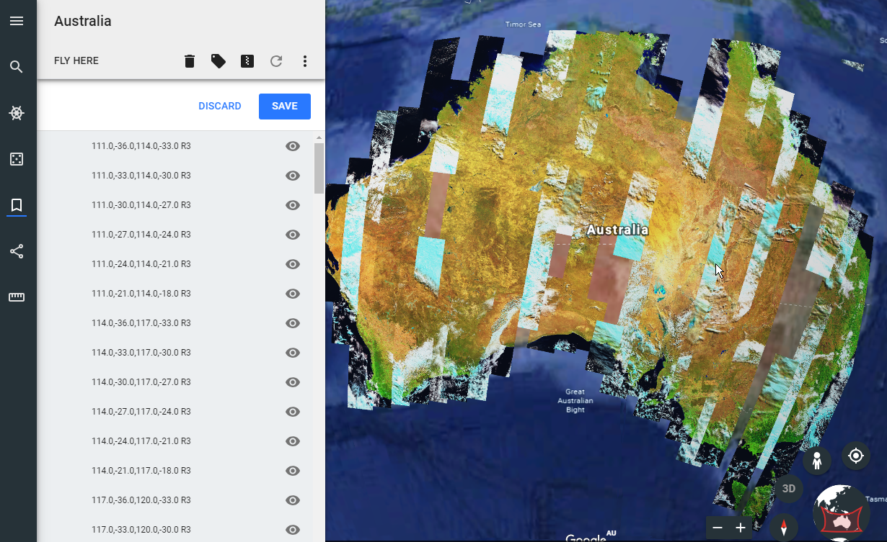
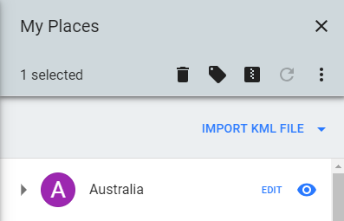
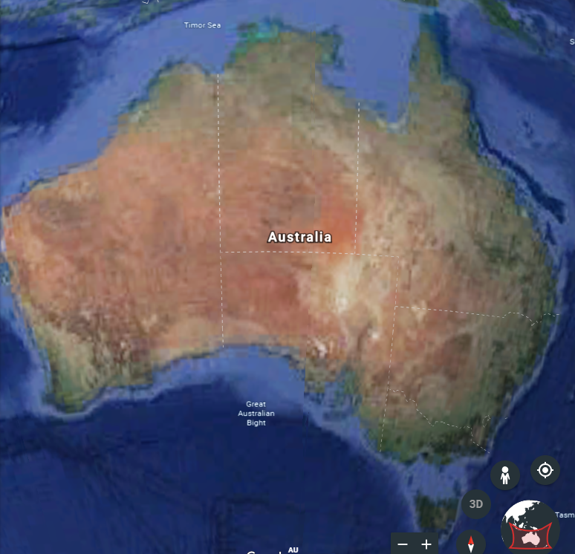
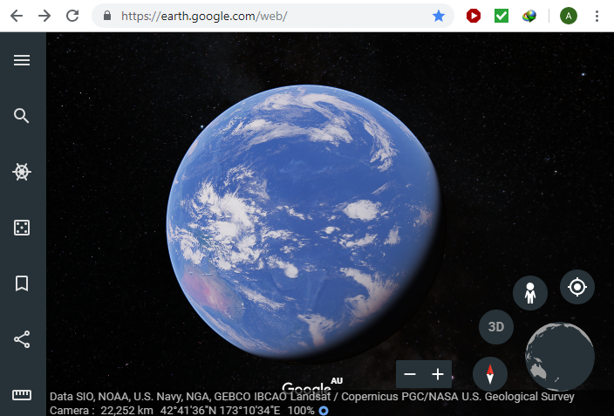
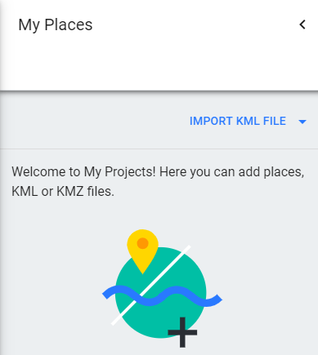


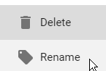
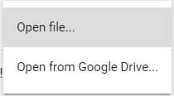
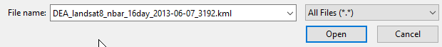
User Guide
Display in Google Earth Web
Google Earth Web: https://earth.google.com/web/
Next: Other Regions
Notes:
Open the map/layers in Google Earth Web:
https://earth.google.com/web/
Go to https://earth.google.com/web/
Click ‘My Places | Import KML’ and locate the saved KML file.
Use the menu icon to display the list of tiles.
Check/uncheck tiles that are to be displayed/masked.
Right click a line to rename it.
NOTES
The display of tiles will take several seconds under low internet speeds.
Click or move the mouse over the map occasionally to prevent the display from going to sleep.

Slide 13
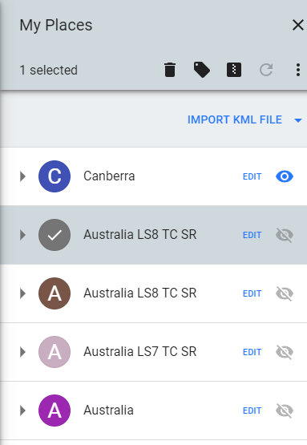
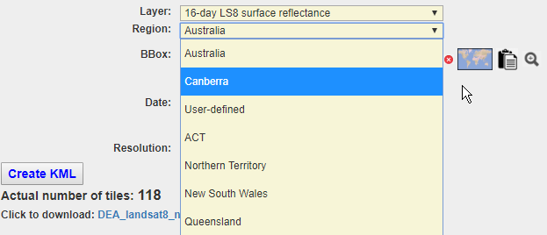
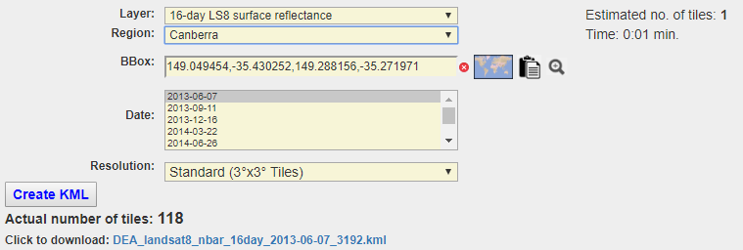
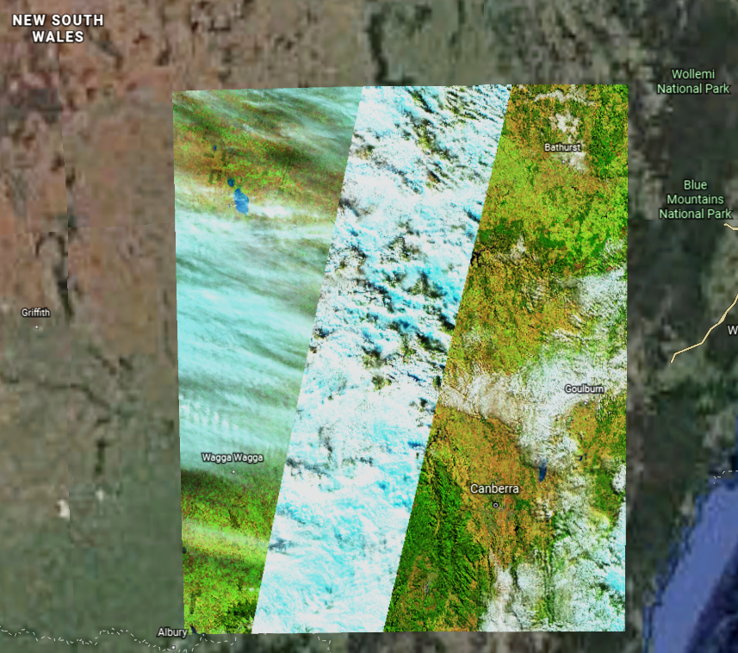
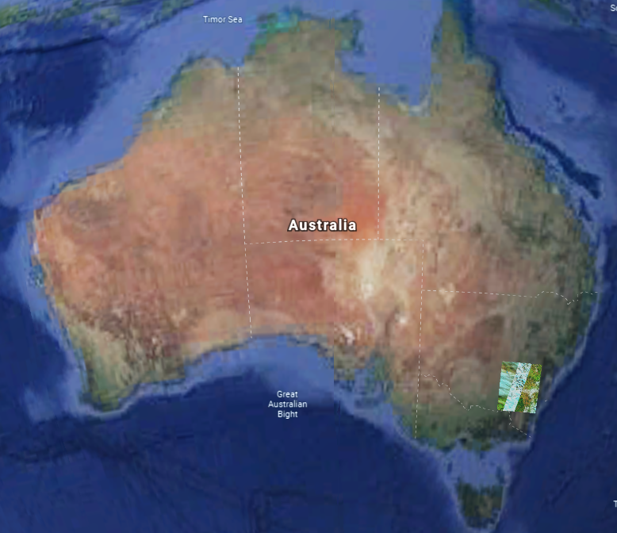
User Guide
https://earth.google.com/web/
Display in Google Earth Web
Next: Custom Coordinates
Notes:
The opened KMLs will be listed under “My Places”.
Check/uncheck the eye icon to show/hide the layers.
Click ‘Edit’ to display the list of tiles and to check/uncheck/rename any tile.
Right-click to rename a layer.

Slide 14
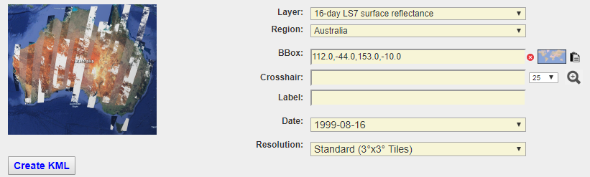
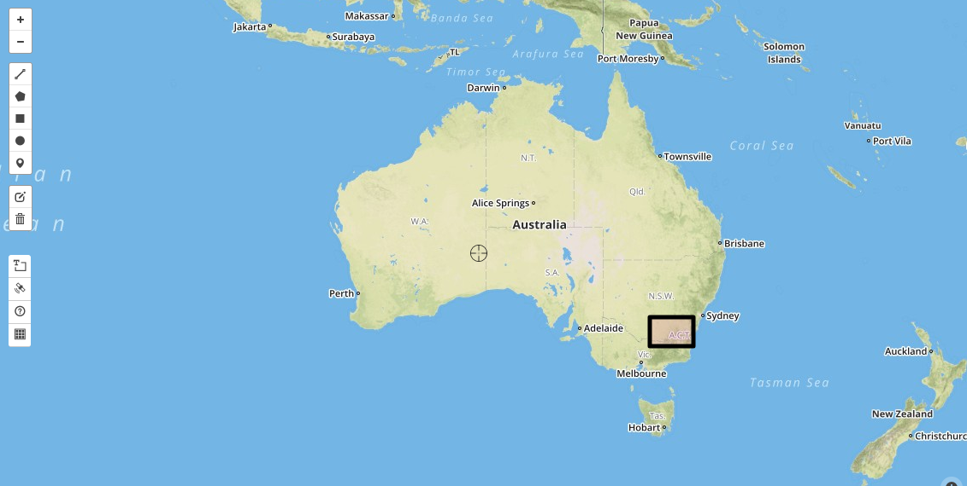
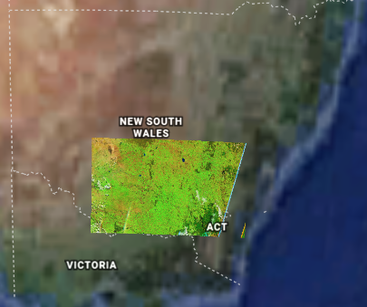
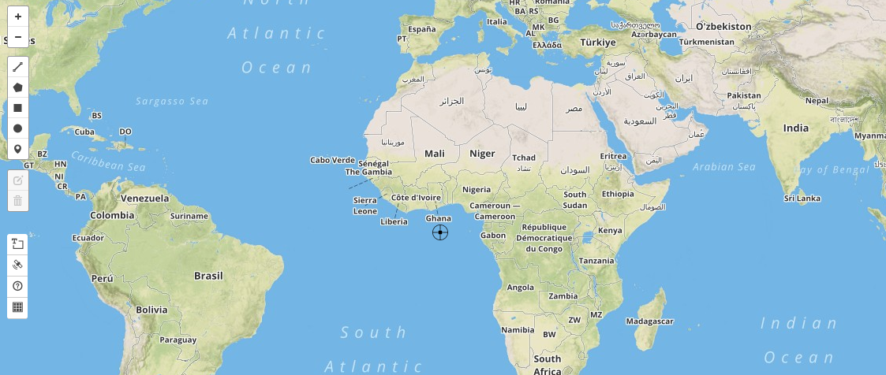
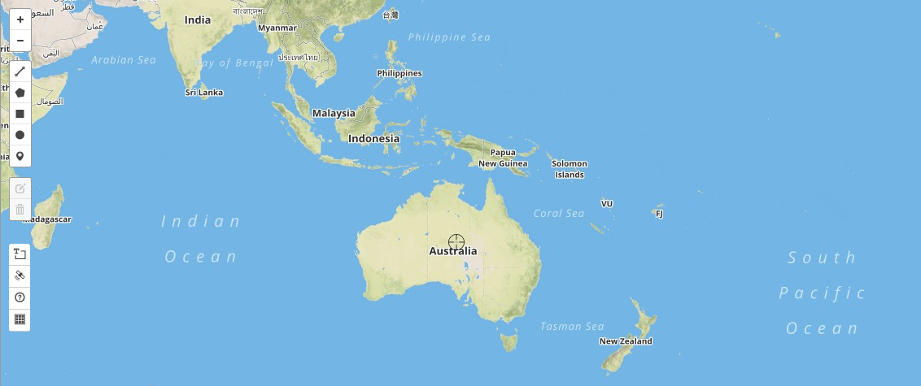
User Guide
Get Bounding Box using BBox Finder
To display the GSKY layers over a region not listed, you can find its Lat/Lon coordinates using an inbuilt “Bbox Finder”.
Next: Zoom around crosshair
Notes:
To zoom into defined bounding box:
Click the map icon.
On the BBox Finder map click the square icon on left frame.
Draw the bounding box.
Click the Paste icon next to the map icon.
Click ‘Create KML’
Download and save the KML file.
NOTES
The bounding box cannot be moved, but can be deleted. Click the ‘Bin’ icon first. Then click inside the BBox and click ‘Save’
Alternatively, close and reopen the BBox Finder by clicking the map icon or the cross above the map.

Slide 15
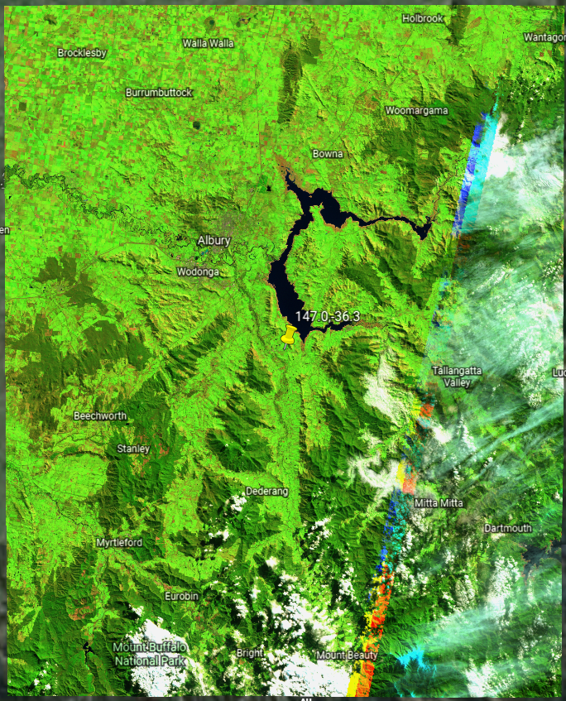
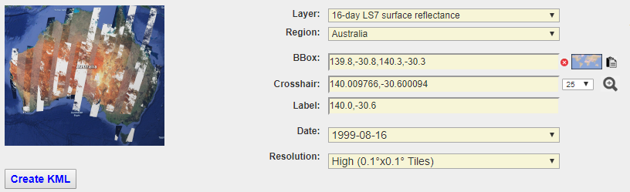
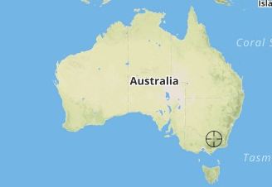
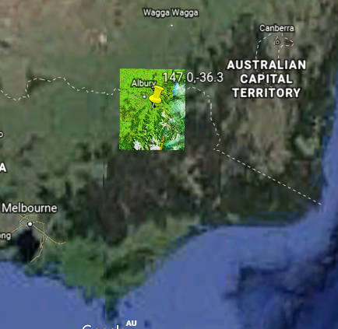
User Guide
Zoom around crosshair
It is possible to zoom around a point to display details in high resolution.
Next: Google Earth Mobile
Notes:
To zoom around a crosshair:
Click the map icon.
Move the map in the Bbox Finder until the crosshair is above a location on the map of Australia.
Click the magnifier glass icon.
Download and save the KML file.

Slide 16
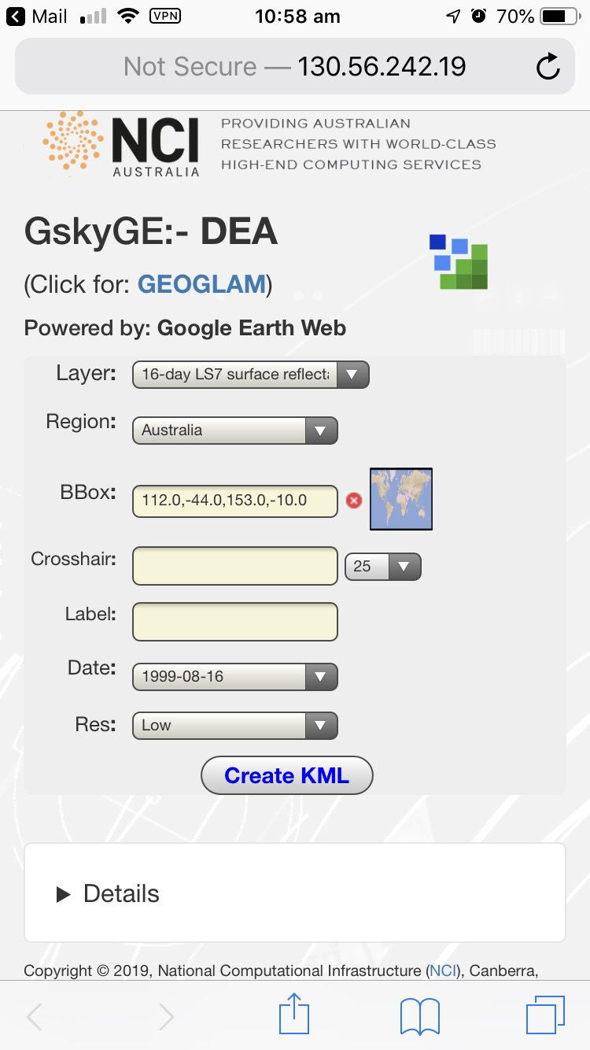
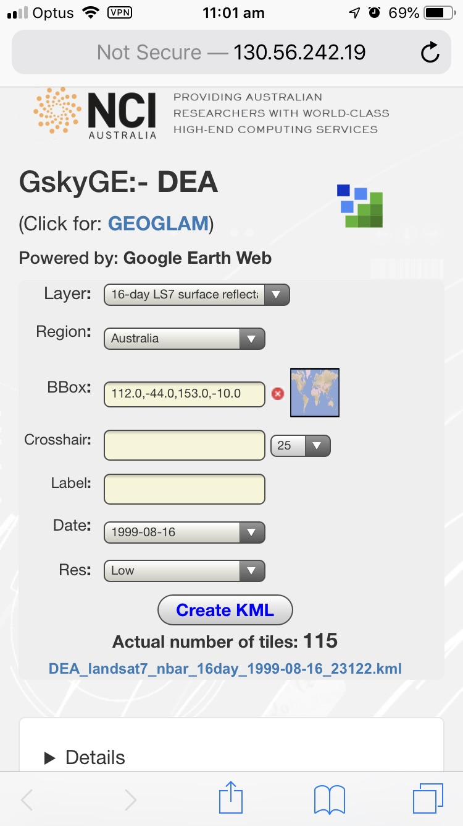
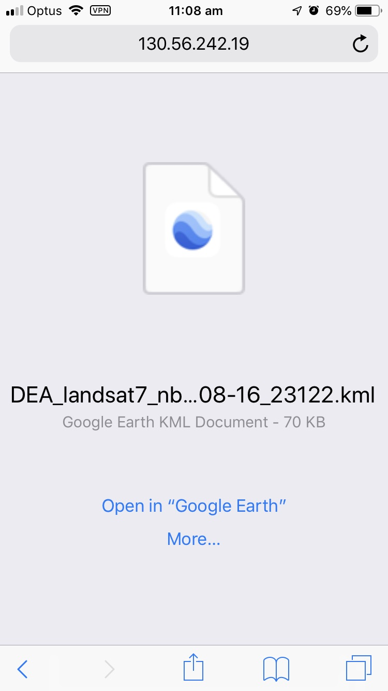
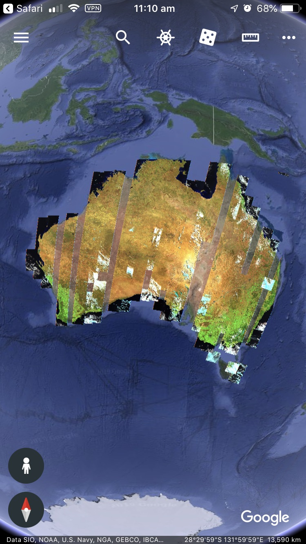
User Guide
On Mobile – Continent Level
The app works on smart mobiles. Require Google Earth App and VPN
Next: On Mobile - Zooming
Notes:
Run the GskyGE App on mobile by accessing the following URL in any browser.
http://130.56.242.19/dea.html
Australia-wide or state-wide display:
Select the layer and region.
Click ‘Create KML’
Click the downloadable link that appears.
Click ‘Open in Google Earth
Click the menu icon on tp left corner to disable the layer or delete it.

Slide 17
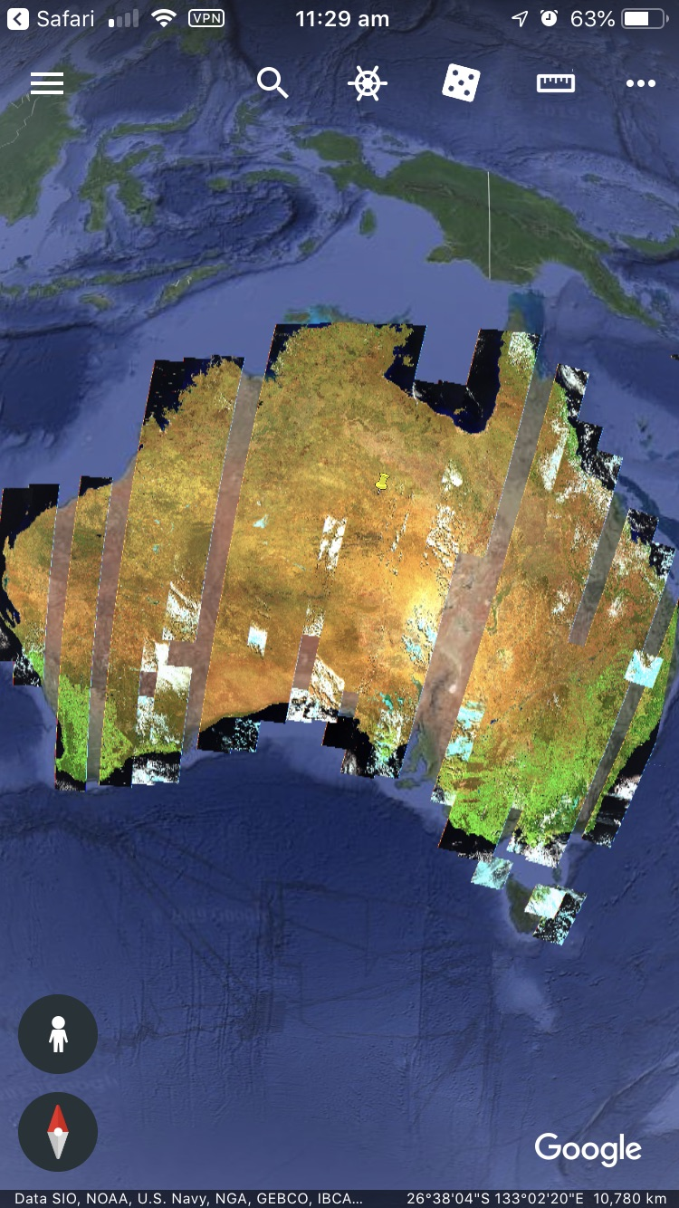
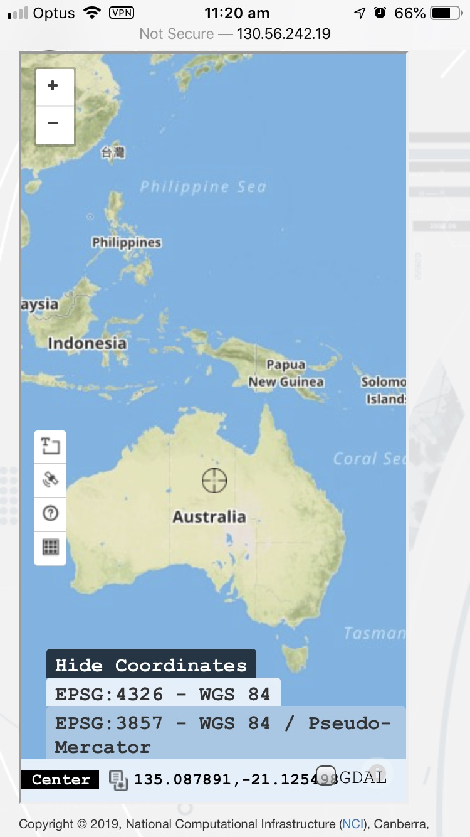
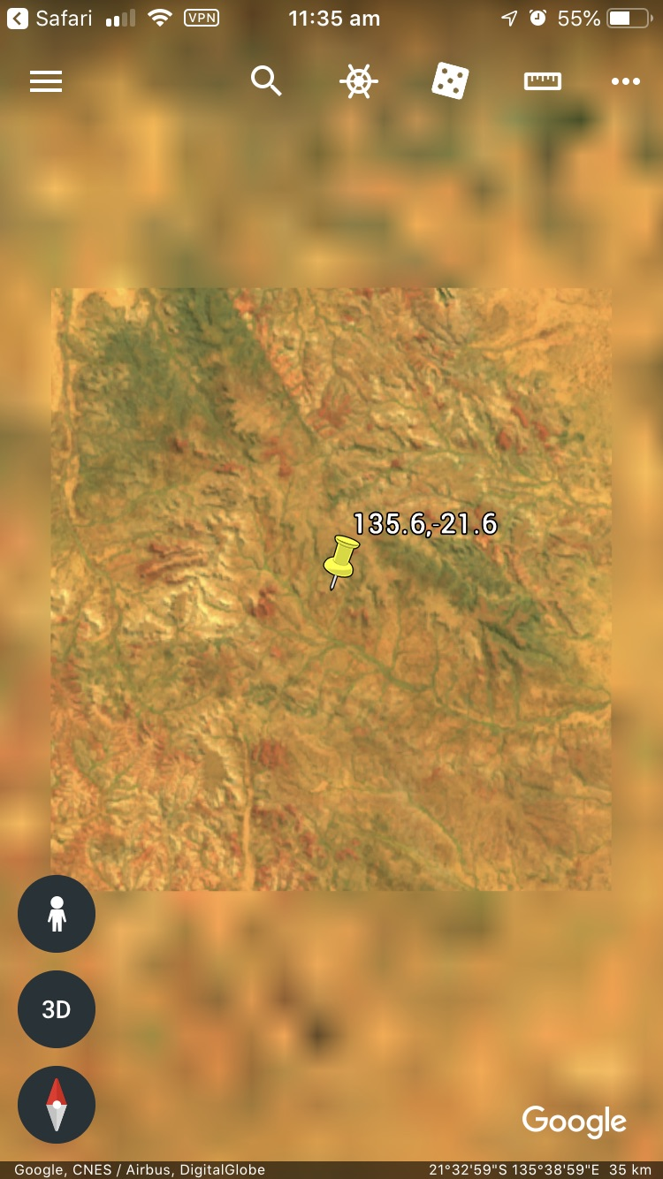
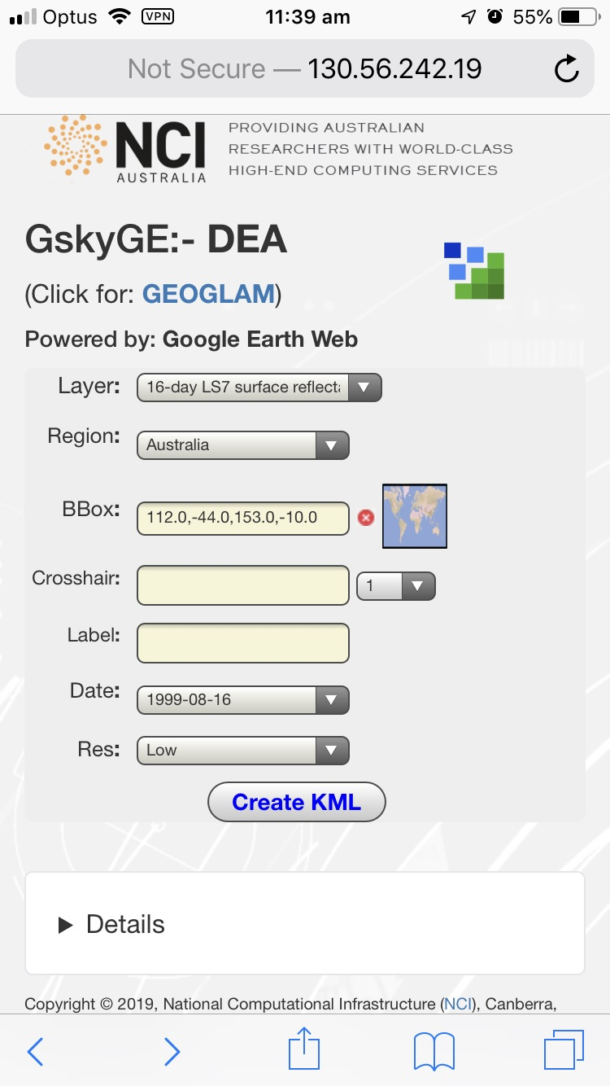

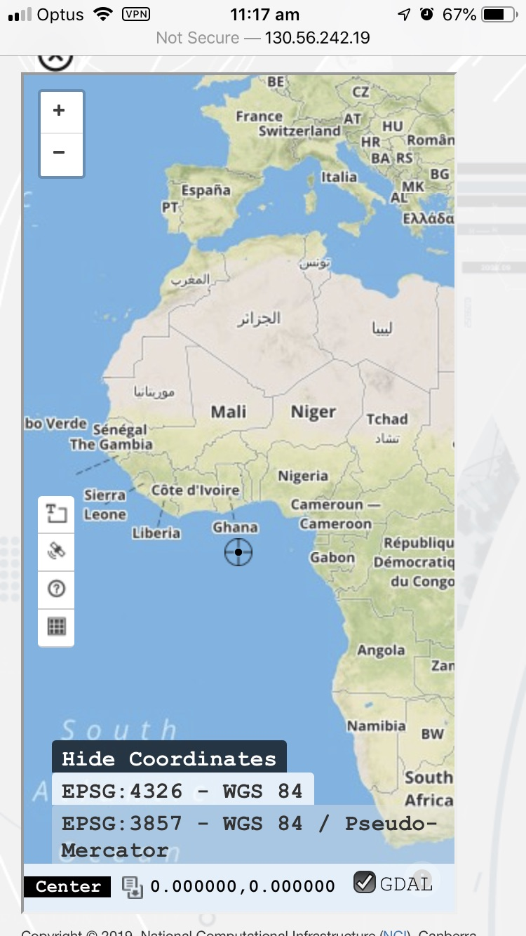
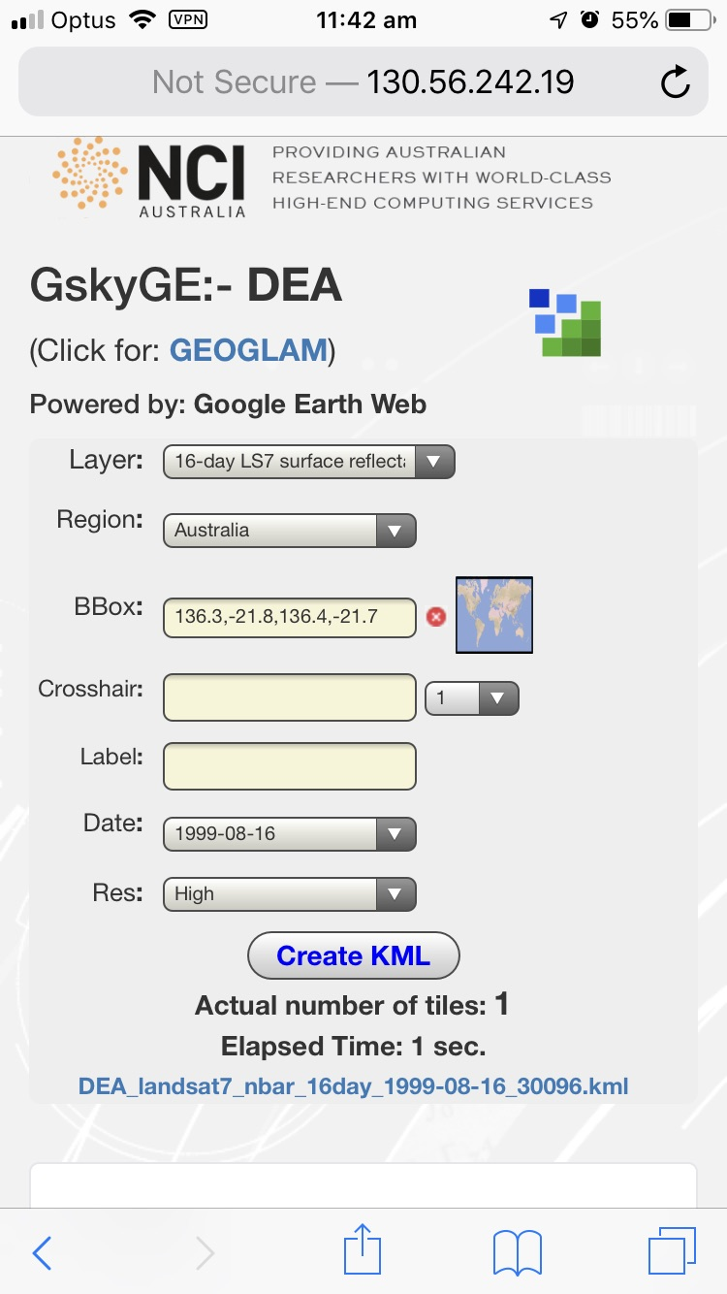
User Guide
On Mobile – Zooming
The app works on smart mobiles. Require Google Earth App and VPN
Next: Setup VPN
Notes:
Run the GskyGE App on mobile by accessing the following URL in any browser.
http://130.56.242.19/dea.html
To zoom in:
Click the map icon to open the Bbox Finder.
Move the map to the right until the crosshair is above Australia and at the required position.
Scroll down (outside the map area) until the ‘GDAL’ button is visible.
Uncheck the GDAL button.
Scroll up again.
Type in a label (optional).
Select the zoom level (Def=25 tiles around the crosshair)
Click the Map icon.
Click the downloadable KML link that appears.
Click ‘Open in Google Earth’
Use the menu to show/hide the Australa-wide map.
Zoom in to an area by clicking ‘Fly Here’ on its entry in the ‘My Places’

Slide 18
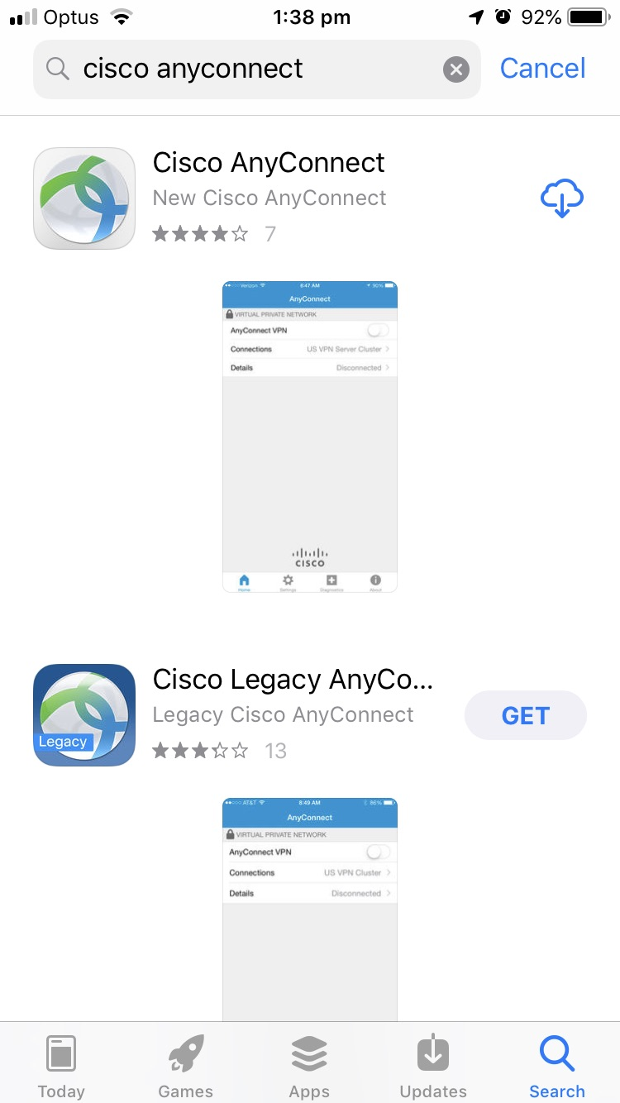
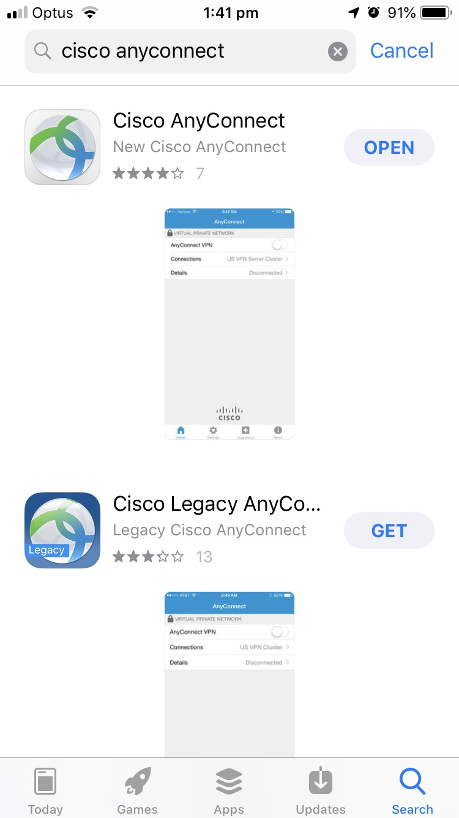
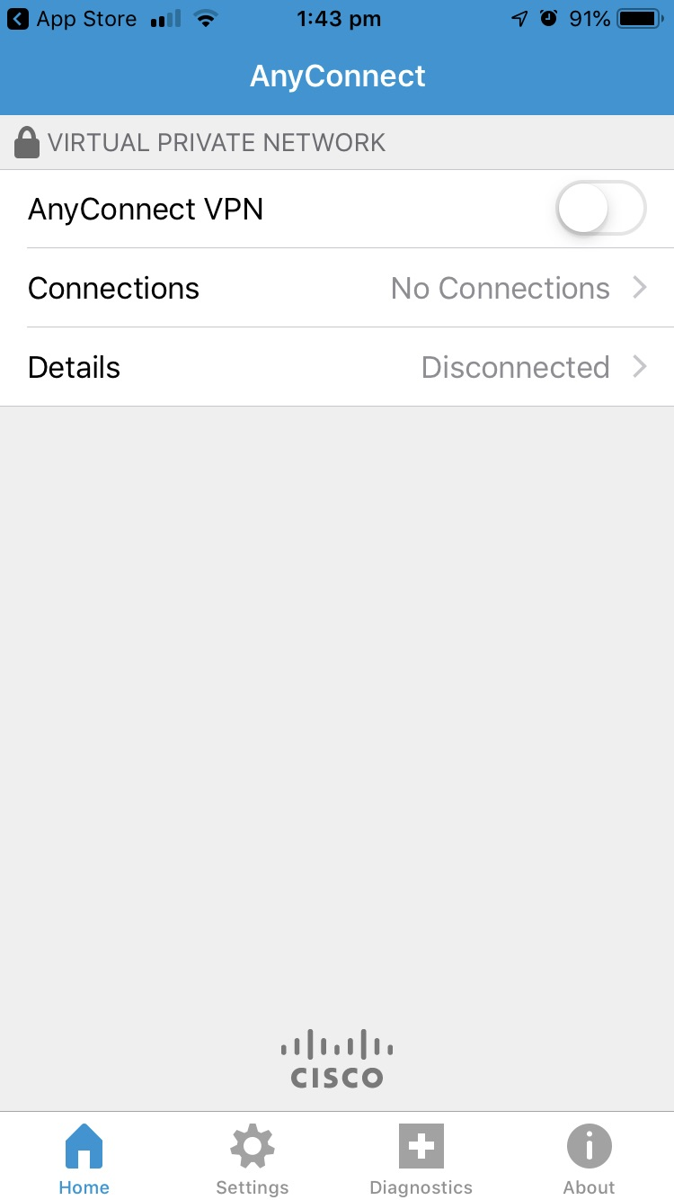
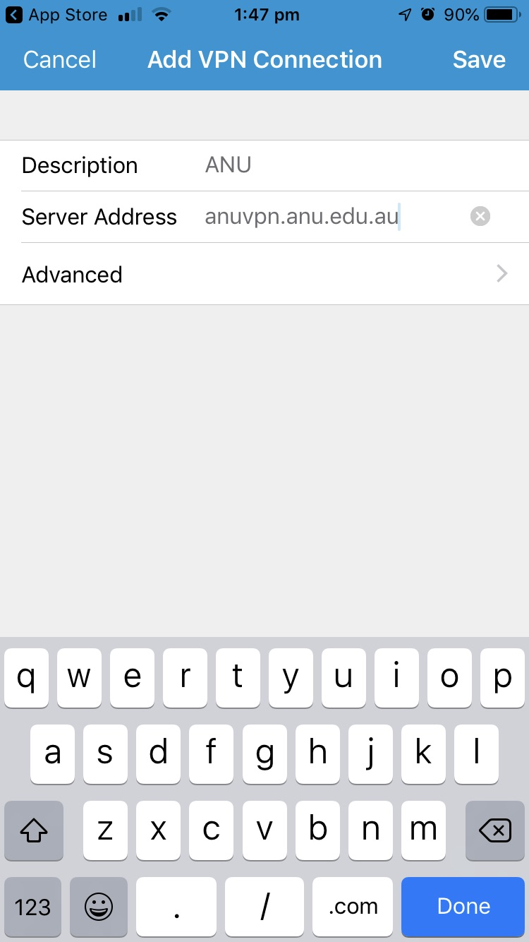
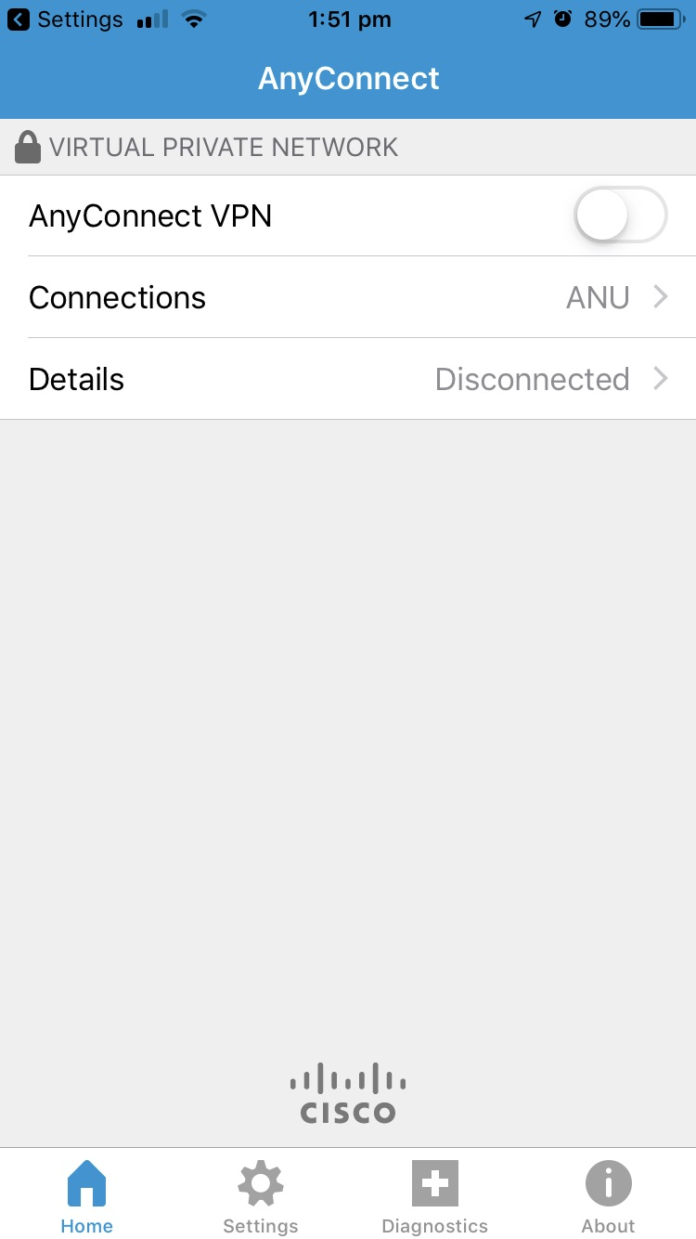
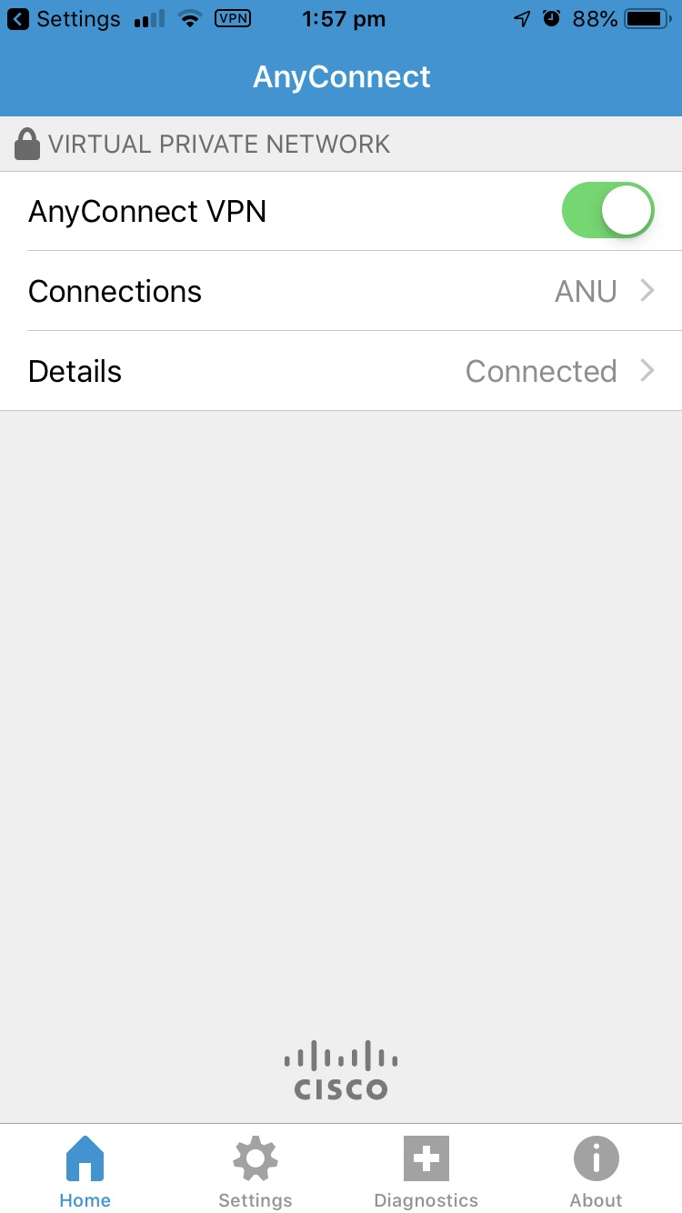
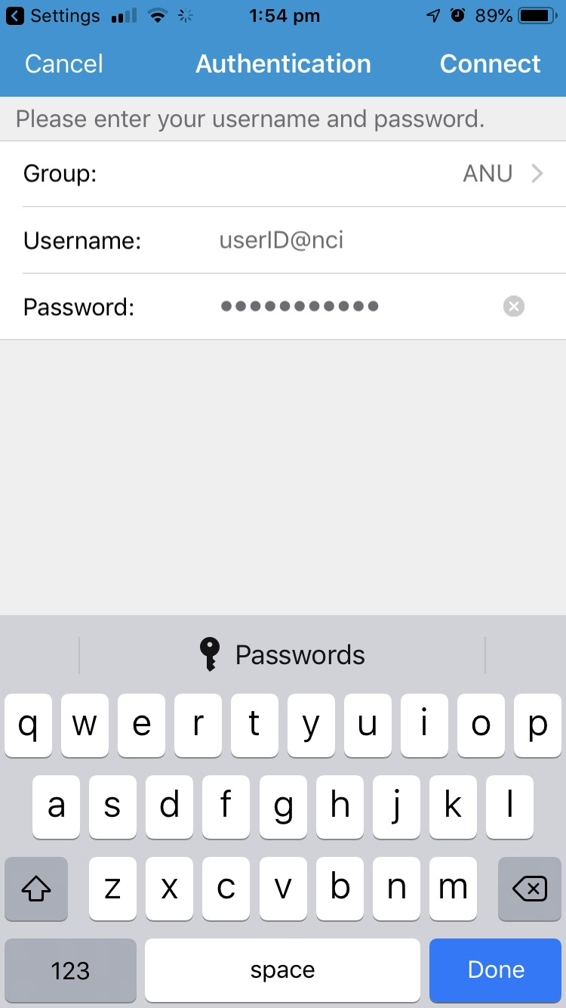
User Guide
Google Earth Mobile - Setup VPN
To use of GskyGE on mobiles, the VPN and Google Earth Apps must be installed.
Next: Google Earth Mobile (Contd.)
Notes:
To setup VPN:
Download the ‘CISCO Anyconnect” app for your mobile.
Click ‘No Connections >’
Type in a description and the URL of your VPN service (e.g. anuvpn.anu.edu.au)
Click ‘Save’
Enter the username as e.g. ‘anuID@nci’ and the password.
Click ‘Connect’.
The VPN will stay connected even if the app is closed. If connection is lost, just reconnect by typing in the password.

Slide 19
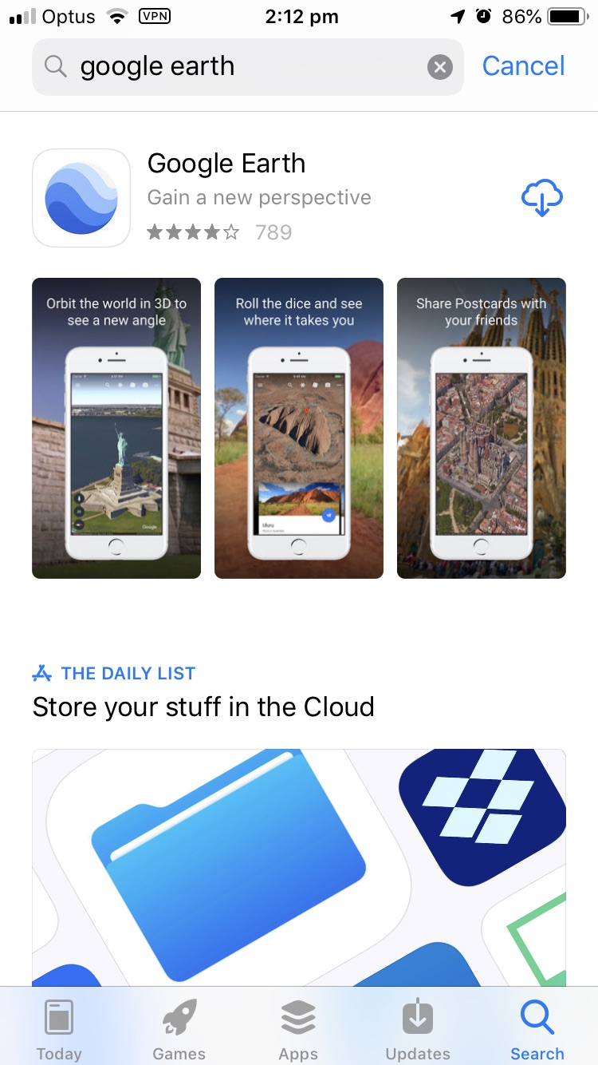
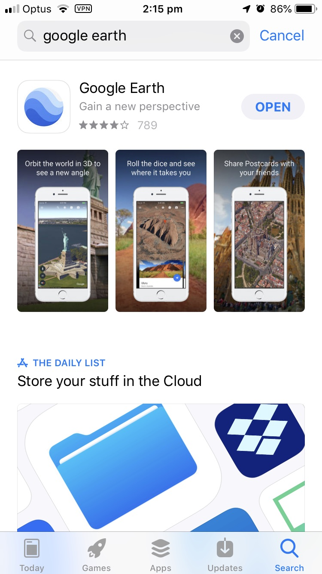
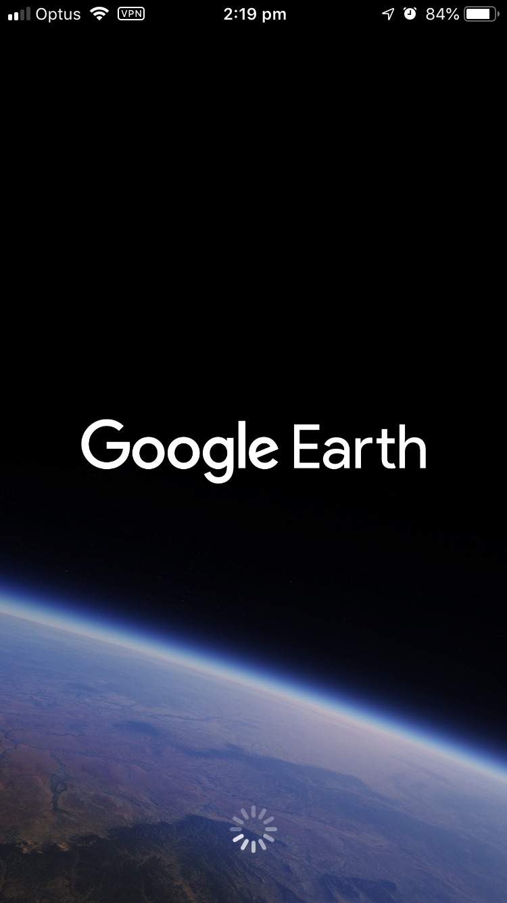
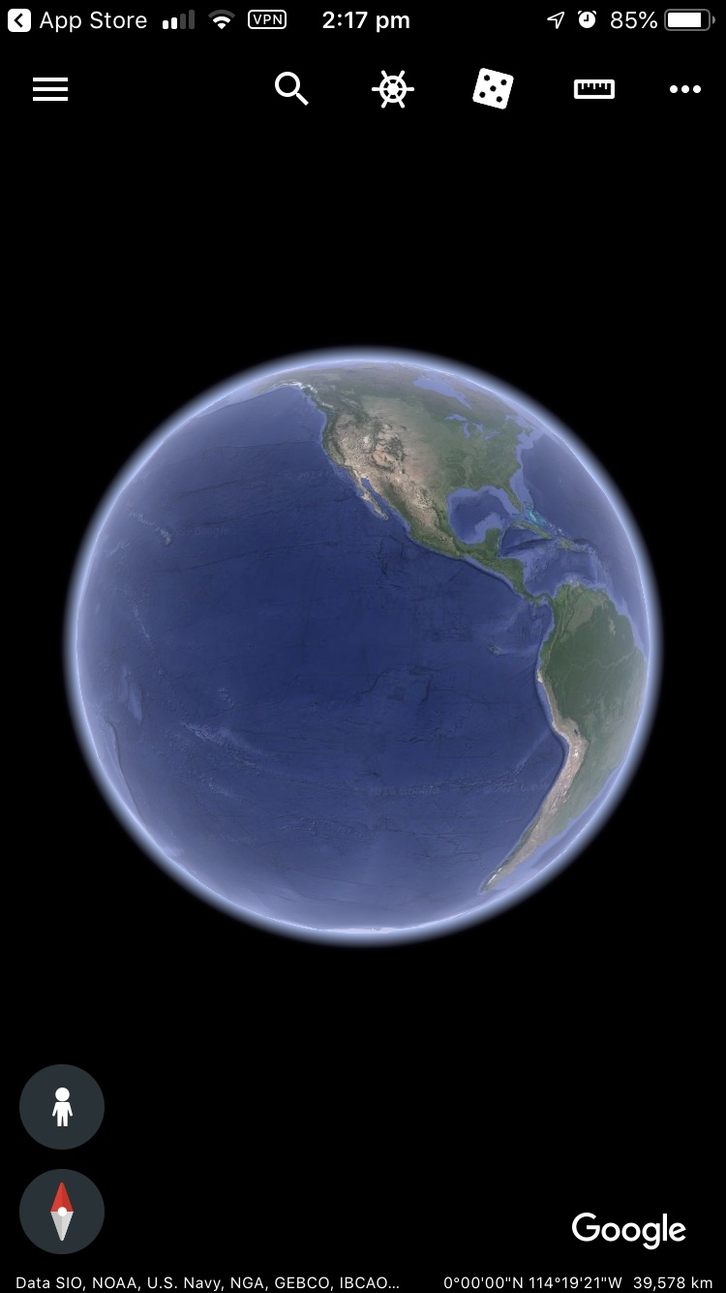
User Guide
Setup Google Earth App
Next: GskyGE on Mobile
Notes:
Download and install Google Earth App.
- Standard procedure to download and install any mobile app.

Slide 20






Acknowledgements

